Slide 1
IS3313 Systems Software
Dr John O’Donoghue

Slide 2
Introduction
Module Objective: To illustrate theoretical concepts in operating systems through their practical application in actual operating systems such as Windows, UNIX and LINUX. Module Content: The module begins with a review of CPU, memory, I/O, peripherals and other essential elements. Core operating systems topics such as the user interface, basic process management, memory management, the input/output systems, file management are then covered. These topics are applied to the Windows desktop and server operating systems. Current approaches to virtualisation are explored in an applied context. The practical element of this module sees students complete unix scripting tutorials which provide them with the skills and competencies for systems administration functions.

Slide 3
Introduction
Learning Outcomes: On successful completion of this module, students should be able to:
Advise business and IS managers on the suitability of CPU and hardware configurations in desktop and server computing platforms
Apply their knowledge of modern operating systems to critically evaluate the suitability of proprietary and open source systems software and match them with business requirements
Plan cutting-edge IT architectures
Explain operating systems administration fundamentals using Windows and Linux
Distinguish between the major CPU architectures on offer from major vendors such as Intel, AMD and ARM.
Explain the relationship between systems software and virtualisation platforms, for example VMWare and Microsoft.
Compare and contrast the advantages and disadvantages of Windows and Linux operating systems
Write shell scripts to manage UNIX network environments.

Slide 4
Introduction
ASSESMENT: Continuous Assessment 100 Marks
- Essay 1 25 Marks
- Essay 2 25 Marks
- Essay 3 25 Marks
- MCQ 25 Marks
Spring Exam 100 Marks
LECTURER: Dr John O’Donoghue
john.odonoghue@ucc.ie

Slide 5
Introduction
What is an operating system?
Early Operating Systems
Simple Batch Systems
Multiprogrammed Batch Systems
Time-sharing Systems
Personal Computer Systems
Parallel and Distributed Systems
Real-time Systems

Slide 6
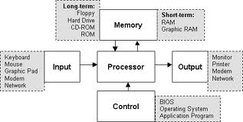
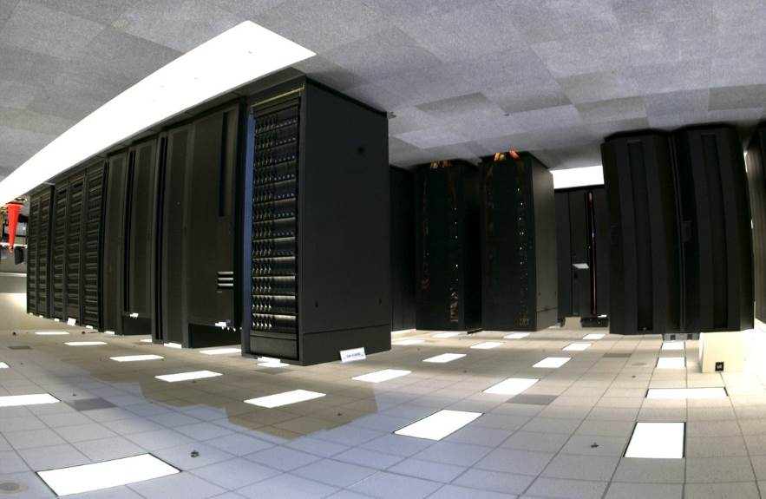
Computer System Architecture

Slide 7
What is an Operating System?
An OS is a program that acts an intermediary between the user of a computer and computer hardware.
Major cost of general purpose computing is software.
OS simplifies and manages the complexity of running application programs efficiently.

Slide 8
Goals of an Operating System
Simplify the execution of user programs and make solving user problems easier.
Use computer hardware efficiently.
Allow sharing of hardware and software resources.
Make application software portable and versatile.
Provide isolation, security and protection among user programs.
Improve overall system reliability
error confinement, fault tolerance, reconfiguration.

Slide 9
Why should I study Operating Systems?
Need to understand interaction between the hardware and applications
New applications, new hardware.
Inherent aspect of society today.
Need to understand basic principles in the design of computer systems
efficient resource management, security, flexibility
Increasing need for specialized operating systems
e.g. embedded operating systems for devices - cell phones, sensors and controllers, wearable technologies …
real-time operating systems - aircraft control, multimedia services

Slide 10
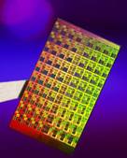
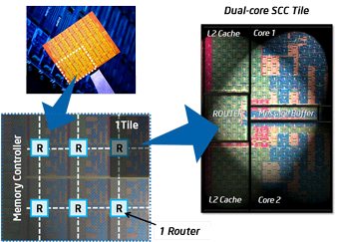
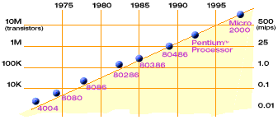
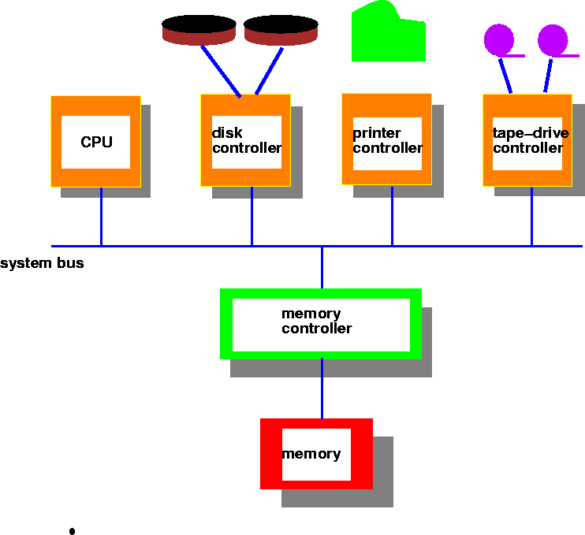
Hardware Complexity Increases
Moore’s Law: 2X transistors/Chip Every 1.5 years
Intel Multicore Chipsets
Moore’s Law

Slide 11
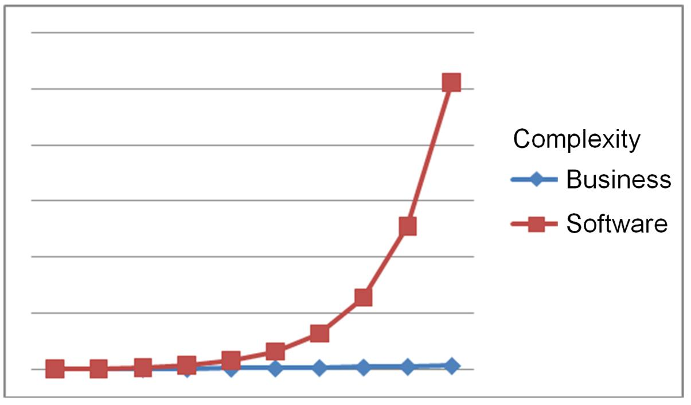
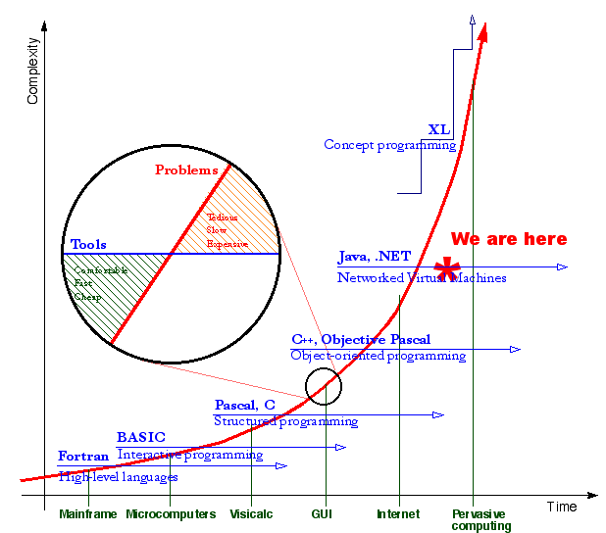
Software Complexity Increases

Slide 12
Computer System Components
Users
People, machines, other computers
Application Programs
Solve computing problems of users (compilers, database systems, video games, business programs such as banking software).
Operating System
Controls and coordinates the use of hardware among application programs.
Hardware
Provides basic computing resources (CPU, memory, I/O devices).
Notes:
Read from bottom up…
Users
Applications
Operating Systems
Hardware

Slide 13
Abstract View of System
User
1
User
2
User
3
...
User
n
System and Application Programs
Compiler
Assembler
text editor
database system
Operating System
Computer
Hardware

Slide 14
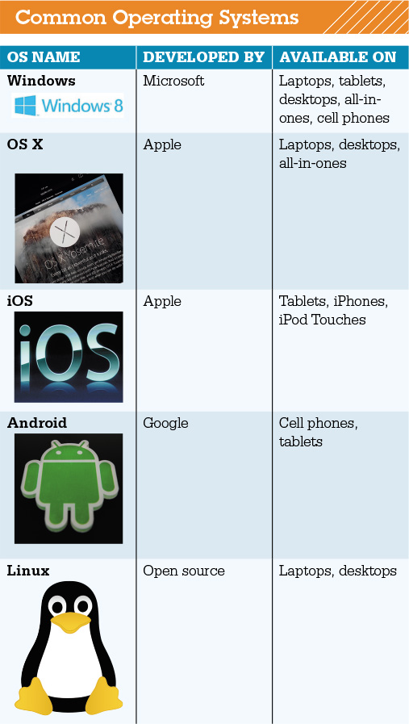
Understanding System Software Operating System Fundamentals
Two basic types of software
Application software
System software
Operating system fundamentals
Multitasking
Networking capabilities
Categorized by type
Notes:
You use application software to do everyday tasks at home and at work.
System software helps run the computer and coordinates instructions between application software and the computer’s hardware devices.
Modern operating systems allow a single user to multitask—to perform more than one process at a time. Operating systems such as Windows and OS X provide networking capabilities as well.
Operating systems can be categorized by the type of device on which they’re installed.

Slide 15
Understanding System Software Operating System Fundamentals
Categorized by device
Mainframes
Network computers
Personal computers, Laptops, Netbooks, Tablets
Mobile devices and Smart Phones
Robots
Notes:
Laptops, tablet computers, and smartphones all need specific operating systems designed to take advantage of their unique characteristics. However, as devices begin to converge in terms of functionality, and operating systems continue to become more powerful, developers such as Microsoft and Apple are making operating systems that have similar functionality or are making single operating systems that can run on multiple devices.

Slide 16
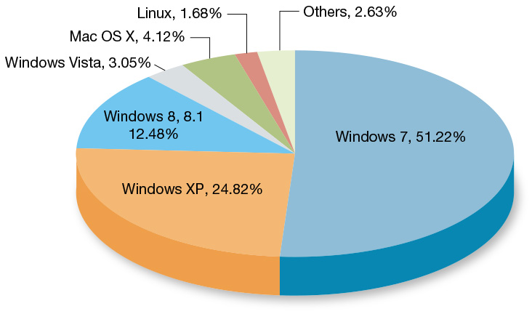
Understanding System Software Operating Systems for Personal Computers
Top three operating systems
Windows
Max OS X
Linux
Windows 10 optimized for touch screen
Cloud-based OS
Notes:
Microsoft Windows, Mac OS X, and Linux are the top three operating systems for personal computers.
The newest release of Microsoft’s OS, Windows 8, provides a new interface optimized for touch-screen devices.
Now that broadband Internet access and providing computer resources via the Internet are becoming more commonplace, operating systems have features that are tied to cloud computing.

Slide 17
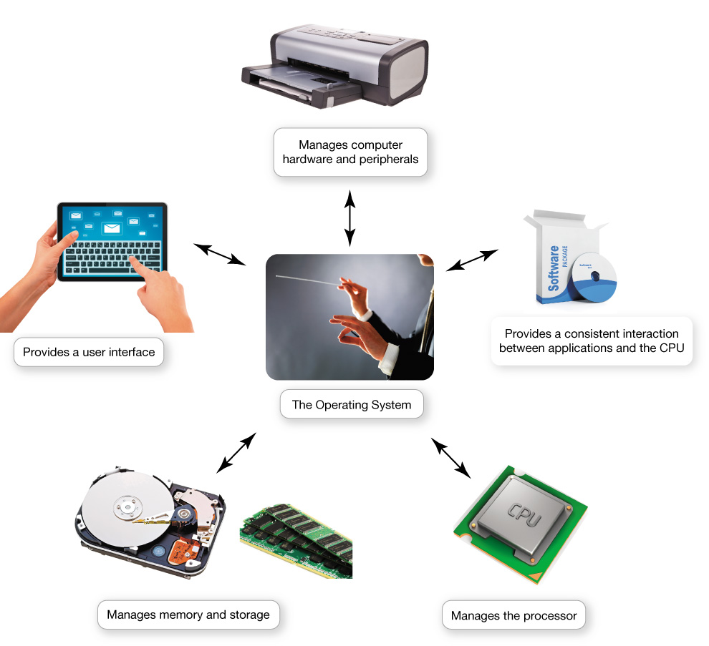
What the Operating System Does
OS - Coordinates and directs the flow of data and information
Notes:
The operating system is like an orchestra's conductor. It coordinates and directs the flow of data and information through the computer system.

Slide 18
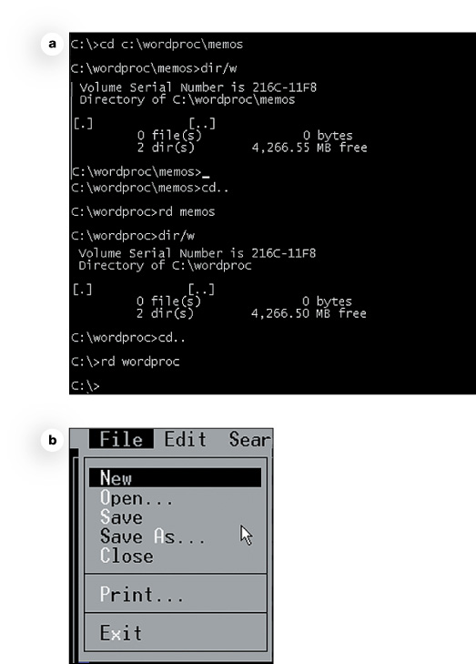
What the Operating System Does The User Interface & I/O Management
Enables user to interact with the computer
Types of interfaces
Command-driven interface
Menu-driven interface
Graphical user interface (GUI)
Notes:
The OS provides a user interface that lets you interact with the computer.
In a command-driven interface you enter commands to communicate with the computer system.
A menu-driven interface is one in which you choose commands from menus displayed on the screen. This eliminated the need for users to know every command.
Current operating systems use a graphical user interface (GUI). GUIs display graphics and use the point-and-click technology of the mouse and cursor.

Slide 19
What the Operating System Does Processor Management
Performs many tasks at once
Arranges execution of activities
Assigns time to activity
Switches among processes
Handles events
Notes:
When computing, you ask the processor to perform several tasks at once.
The CPU still needs the OS to arrange for the execution of all these activities.
The OS assigns a slice of its time to each activity. It must switch among different processes millions of times a second.
Every keystroke, mouse click, and signal to the printer creates an action, or event, in the respective devices to which the OS responds.

Slide 20
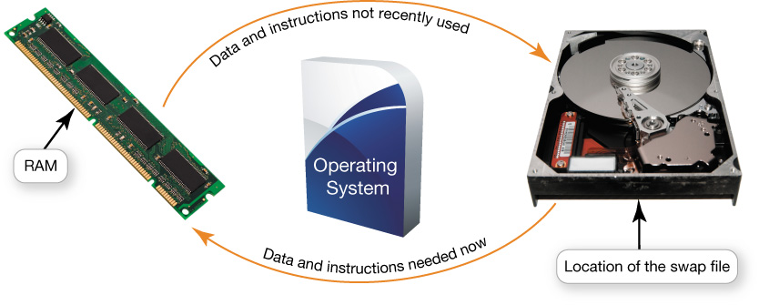
What the Operating System Does Virtual Memory Management
RAM - limited capacity
Full RAM - Instructions are stored on hard drive
Borrowing drive space is called virtual memory
Increase RAM to avoid using virtual memory
Notes:
RAM has limited capacity.
When there isn’t enough room in RAM, it borrows room from the hard drive.
Borrowing hard drive space is called virtual memory.
When more RAM is needed, the OS swaps out from RAM data or instructions that haven't been used recently and moves them to a temporary storage area on the hard drive.
Increasing the amount of RAM helps to avoid having to send data and instructions to virtual memory.

Slide 21
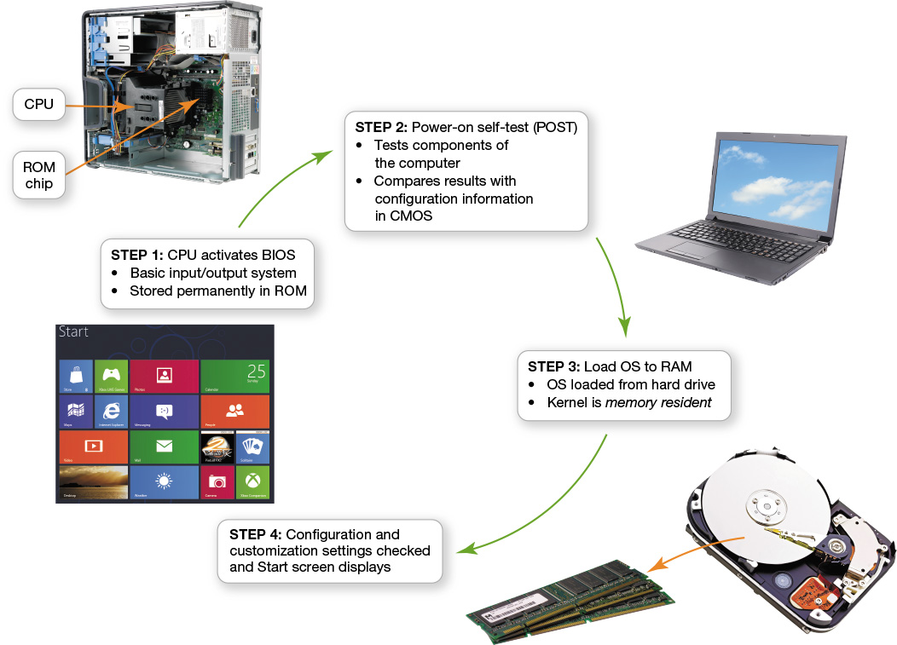
The Boot Process: Starting the Computer
The boot process loads the operating system into RAM
Notes:
The boot process loads the OS into RAM. The term boot, from bootstrap loader, alludes to the straps of leather, called bootstraps, that people used to use to help them pull on their boots.

Slide 22
OS Fundamentals
Back to the Future

Slide 23
Operating System Views
Resource allocator
to allocate resources (software and hardware) of the computer system and manage them efficiently.
Control program
Controls execution of user programs and operation of I/O devices.
Kernel
The program that executes forever (everything else is an application with respect to the kernel).

Slide 24
OS Functions
Process management
Memory management
File system management
Device management
Network management (TCP/IP, UDP)
Security (Process/Memory protection)
I/O management

Slide 25
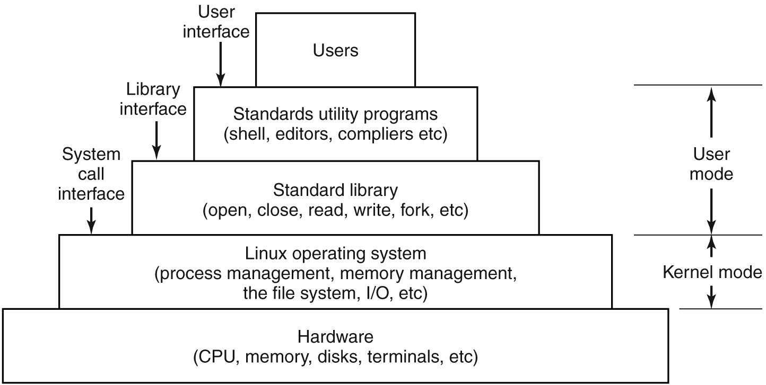
UNIX

Slide 26
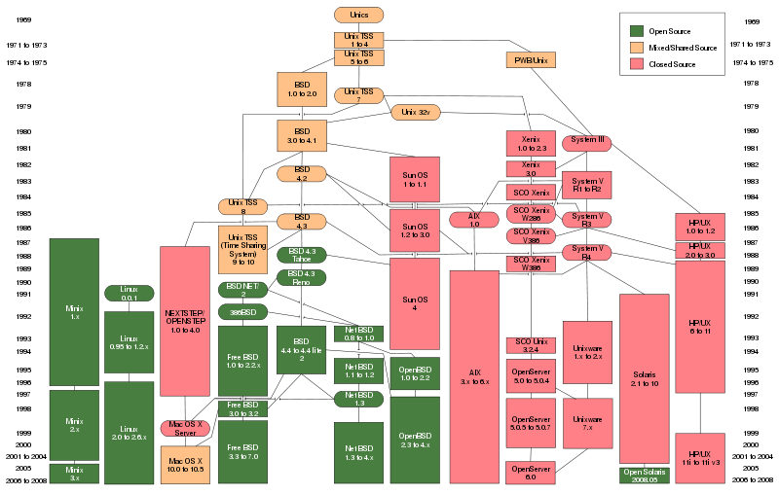
UNIX Evolution

Slide 27
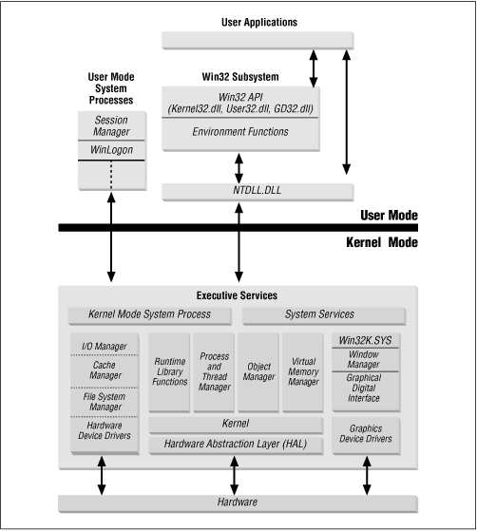
Windows

Slide 28
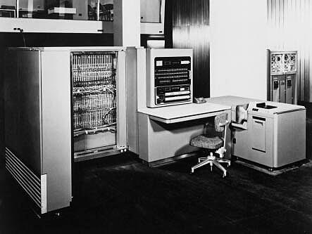
Early Systems - Bare Machine (1950s)
Hardware – expensive ; Human – cheap
Structure
Large machines run from console
Single user system
Programmer/User as operator
Paper tape or punched cards
Early software
Assemblers, compilers, linkers, loaders, device drivers, libraries of common subroutines.
Secure execution
Inefficient use of expensive resources
Low CPU utilization, high setup time.

Slide 29
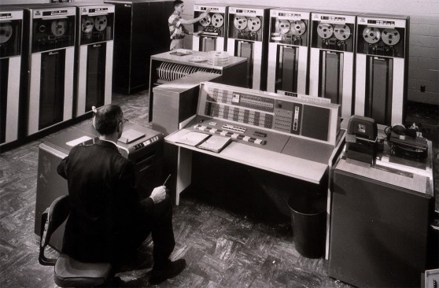
Simple Batch Systems (1960’s)
Reduce setup time by batching jobs with similar requirements.
Add a card reader, Hire an operator
User is NOT the operator
Automatic job sequencing
Forms a rudimentary OS.
Resident Monitor
Holds initial control, control transfers to job and then back to monitor.
Problem
Need to distinguish job from job and data from program.

Slide 30
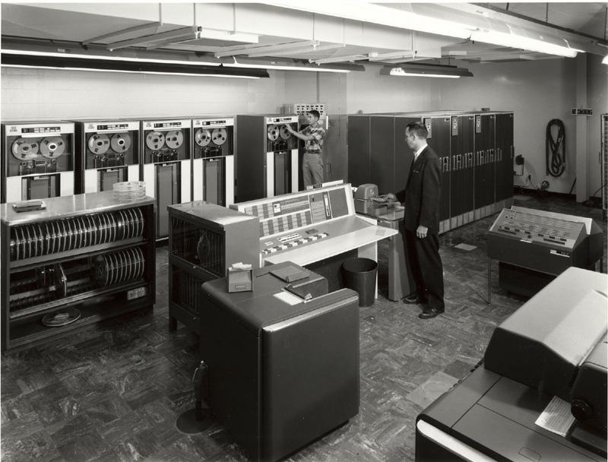
Supervisor/Operator Control
Secure monitor that controls job processing
Special cards indicate what to do.
User program prevented from performing I/O
Separate user from computer
User submits card deck
cards put on tape
tape processed by operator
output written to tape
tape printed on printer
Problems
Long turnaround time - up to 2 DAYS!!!
Low CPU utilization
I/O and CPU could not overlap; slow mechanical devices.
IBM 7094

Slide 31
Batch Systems - I/O completion
How do we know that I/O is complete?
Polling:
Device sets a flag when it is busy.
Program tests the flag in a loop waiting for completion of I/O.
Interrupts:
On completion of I/O, device forces CPU to jump to a specific instruction address that contains the interrupt service routine.
After the interrupt has been processed, CPU returns to code it was executing prior to servicing the interrupt.

Slide 32
Multiprogramming
Use interrupts to run multiple programs simultaneously
When a program performs I/O, instead of polling, execute another program till interrupt is received.
Requires secure memory, I/O for each program.
Requires intervention if program loops indefinitely.
Requires CPU scheduling to choose the next job to run.

Slide 33
Timesharing
Programs queued for execution in FIFO order.
Like multiprogramming, but timer device interrupts after a quantum (timeslice).
Interrupted program is returned to end of FIFO
Next program is taken from head of FIFO
Control card interpreter replaced by command language interpreter.
Hardware – getting cheaper; Human – getting expensive

Slide 34
Timesharing (cont.)
Interactive (action/response)
when OS finishes execution of one command, it seeks the next control statement from user.
File systems
online filesystem is required for users to access data and code.
Virtual memory
Job is swapped in and out of memory to disk.

Slide 35
Personal Computing Systems
Single user systems, portable.
I/O devices - keyboards, mice, display screens, small printers.
Laptops and palmtops, Smart cards, Wireless devices.
Single user systems may not need advanced CPU utilization or protection features.
Advantages:
user convenience, responsiveness, ubiquitous
Hardware – cheap ; Human – expensive

Slide 36
Parallel Systems
Multiprocessor systems with more than one CPU in close communication.
Improved throughput, economical, increased reliability.
Kinds:
Vector and pipelined
Symmetric and asymmetric multiprocessing
Distributed memory vs. shared memory
Programming models:
Tightly coupled vs. loosely coupled ,message-based vs. shared variable

Slide 37
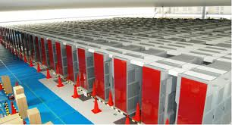
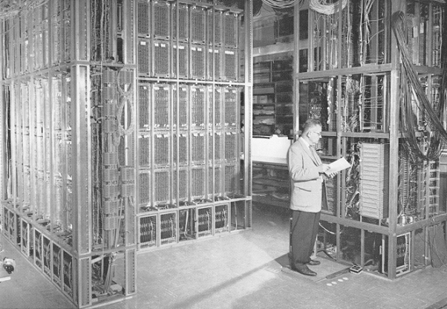
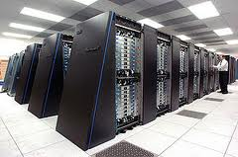
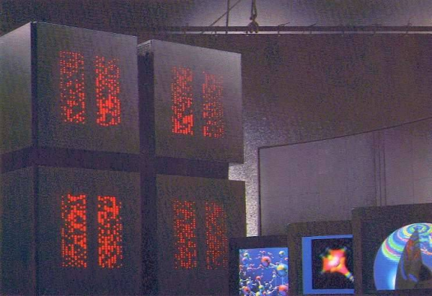
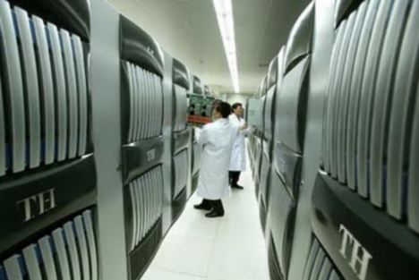
Parallel Computing Systems
Climate modeling, earthquake simulations, genome analysis, protein folding, nuclear fusion research, …..
ILLIAC 2 (UIllinois)
K-computer(Japan)
Tianhe-1(China)
IBM Blue Gene
Connection Machine (MIT)

Slide 38
Distributed Systems
Distribute computation among many processors.
Loosely coupled -
no shared memory, various communication lines
client/server architectures
Advantages:
resource sharing
computation speed-up
reliability
communication - e.g. email
Applications - digital libraries, digital multimedia
Hardware – very cheap ; Human – very expensive

Slide 39
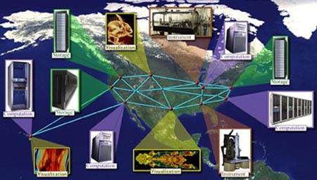
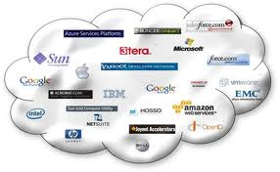
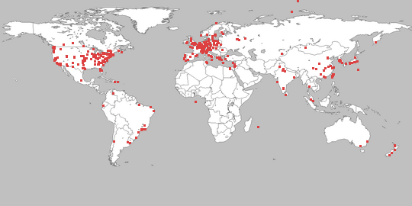
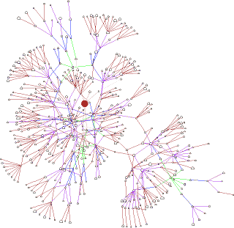
Distributed Computing Systems
Globus Grid Computing Toolkit
Cloud Computing Offerings
PlanetLab
Gnutella P2P Network

Slide 40
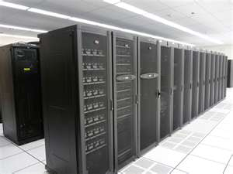
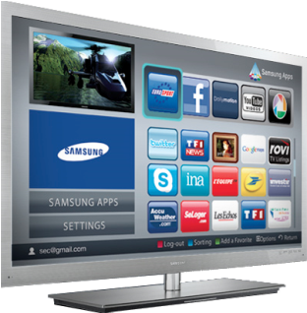
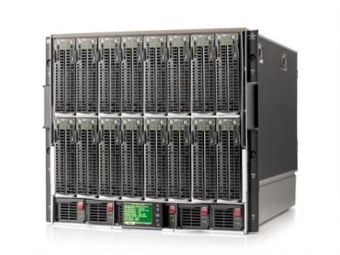
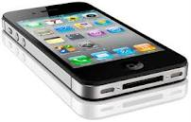
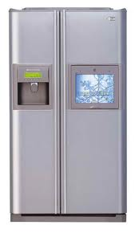
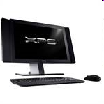
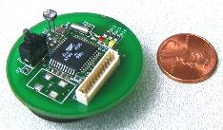
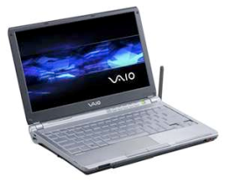
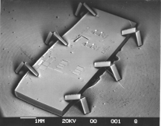
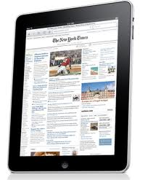
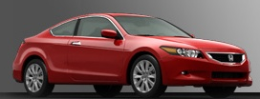
Societal Scale Information Systems
Massive Cluster
The world is a large distributed system
Microprocessors in everything
Vast infrastructure behind them
Gigabit Ethernet
Massive Cluster
Clusters
Clusters
Gigabit Ethernet
Internet Connectivity
Scalable, Reliable,
Secure Services
Databases
Information Collection
Remote Storage
Online Games
Commerce
…
MEMS for
Sensor Nets
Notes:
Of the enormous variety of CITRIS projects going on at Berkeley, I will present one set that is tied together by this picture: the design, construction and use of MEMS devices, the sensor networks containing them, and making the information from these networks available to widely distributed users as scalable, reliable and secure services.
The name we give to such an integrated system is a Societal Scale Information System, a name meant to evoke its scale – enormous - and purpose – benefiting people and the economy.
I will leave the details of all the specific applications that Ruzena mentioned, be it to energy efficiency or education or disaster response the social sciences, and indeed most details, to later talks and posters.

Slide 41

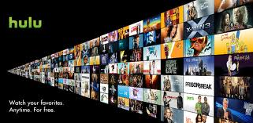
Real-time systems
Correct system function depends on timeliness
Feedback/control loops
Sensors and actuators
Hard real-time systems -
Failure if response time too long
Secondary storage is limited
Soft real-time systems -
Less accurate if response time is too long.
Useful in applications such as multimedia, virtual reality

Slide 42
How do Operating Systems Work?
An operating system may be divided into several key components:
The kernel
Resource managers (Windows Executive)
Device drivers (including file system drivers)
Shell/GUI
Hardware dependent code (Windows HAL)

Slide 43
Lecture Summary So Far…
What is an operating system?
Early Operating Systems
Simple Batch Systems
Multiprogrammed Batch Systems
Time-sharing Systems
Personal Computer Systems
Parallel and Distributed Systems
Real-time Systems

Slide 44
A quick review and more fundamentals

Slide 45
Software Hierarchy
Application software
System software
Firmware
Hardware
Computer Logic Circuits

Slide 46
Software Hierarchy
The diagram represents the relationship between the various types of software and hardware.
Inverted pyramid to reflect the relative size and number of the various types of software, on one hand, and their proximity to computer hardware, on the other
i.e. Higher up in diagram =
bigger and greater variety of software
further away from the hardware

Slide 47
Application software (1)
Also called end-user programs
E.g. database apps, word processors, spreadsheets
Cannot run without the operating system
Is remote from, and rarely interacts with, the computer’s hardware
This is particularly true of applications that run on modern operating systems such as Windows NT 4.0, 2000, XP, Vista, 7 and 8 and UNIX variants

Slide 48
Application software (2)
In the past, application programs were written for use with specific operating systems—the majority still are.
Many were often optimized to run on particular CPUs (CISC or RISC, 16, 32 or 64 bit) to take advantage of processor optimization and other features.
CISC (complex instruction set computer) &
RISC (reduced instruction set computer) are CPU architectures
Such applications, whether written in C, C++ or Visual basic, communicate with the operating system via system calls or through the Application Programming Interface (API).

Slide 49
Application software – APIs (1)
Application Programming Interface (API) allows applications to make ‘system calls’ to request services from components in the kernel so the app can carry out tasks
Application developer just has to know what routines to call in order to achieve the desired task
User space: contains components the are not part of the OS and cannot directly access system resources
Kernel space: contains components that are part of the OS and have unrestricted access to system resources

Slide 50
Application software – APIs (2)
Application
Application
Application
User space
Kernel space
System call interface
OS components
Kernel = software containing the core components of the OS

Slide 51
Application software Multithreading
More sophisticated applications also take advantage of multithreading features of 32 and 64 bit operating systems (e.g. Microsoft Windows, Linux, Sun Solaris, Mac OS-X etc.)
Multithreading: an OS executing different threads of the program simultaneously. The program must be written such that the threads can run without interfering with each other.
However, all this is operating system dependant

Slide 52
CLR and JVM
By 2000, with the advent of the .NET and Java paradigms, applications became even further removed from hardware
.NET’s Common Language Runtime (CLR) and the Java Virtual Machine (JVM) provide operating system and hardware access for Java and .NET application written for use on multiple platforms
Note that .NET programs currently run only on Windows operating systems (2000, XP, ME, NT etc.)

Slide 53
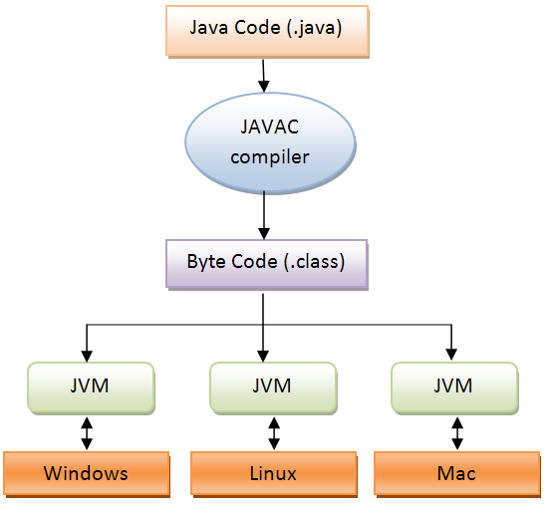
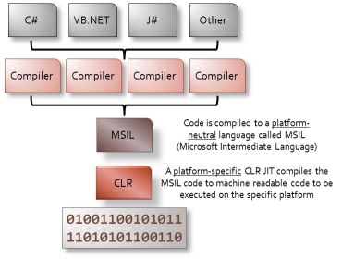
JAVA VM and CLR

Slide 54
Software Hierarchy
Application software
System software
Firmware
Hardware
Computer Logic Circuits

Slide 55
System Software - What is an Operating System? (1)
An operating system (OS) is a program that
controls the execution of application programs, and
manages hardware resources
It is implemented as a layer of software that takes care of technical aspects of a computer's operation.
It hides low-level details of specific hardware platforms and provides required functionality to users and applications
Prevents concurrently running applications from interfering with each other

Slide 56
System Software - What is an Operating System? (2)
Since the OS controls a computer, all requests to use its resources and devices need to go through the OS.
An OS therefore provides legal entry points into its code via the API for performing basic operations like writing to devices.
Operating systems are classified by both
how many tasks they can perform simultaneously i.e. single-task or multitasking;
and by
how many users can be using the system at any one time i.e. single-user or multi-user
However, multi-user system also multitask

Slide 57
Key elements of an Operating System
Operating systems have several key elements:
a technical layer of software for controlling the hardware of the computer, like the CPU, memory, disk drives, the keyboard and the video screen.
a filesystem which provides a way of organizing files logically, and
a simple command language or graphical user interface that enables users to run applications and manipulate files
Some operating systems also provide Internet browsers, administration tools, text editors, compilers, debuggers and a variety of other utilities

Slide 58
Operating Systems Threads (1)
Thread =
Fundamental unit of program execution in modern OS
Independently executable stream of instructions
Threads are
logical sub-units of programs
well-bounded classes
objects or modules that can be scheduled for CPU access
Benefits
Help reduce the memory management overhead for OSs
Speed up OS and application performance
Notes:
Multithreading computers have hardware support to efficiently execute multiple threads. These are distinguished from multiprocessingsystems (such as multi-core systems) in that the threads have to share the resources of single core: the computing units, the CPU caches and the translation lookaside buffer (TLB). Where multiprocessing systems include multiple complete processing units, multithreading aims to increase utilization of a single core by leveraging thread-level as well as instruction-level parallelism. As the two techniques are complementary, they are sometimes combined in systems with multiple multithreading CPUs and in CPUs with multiple multithreading cores.

Slide 59
Operating Systems Threads (2)
Threads come in to their own in multiprocessing systems, which are based on computers with 2 or more CPUs.
In such systems both the CPUs and the host OS have to be configured to support multiple CPU use by applications.
E.g. Windows employs Symmetric Multiprocessing (SMP)
Multiple identical processors connect to a single shared main memory
Most common multiprocessor systems today use an SMP architecture
With multi-core processors, SMP treats the cores as separate processors
Workload balancing
Multithreading = an OS executing different threads of the program simultaneously. The program must be written such that the threads can run without interfering with each other.
Notes:
Multithreading computers have hardware support to efficiently execute multiple threads. These are distinguished from multiprocessingsystems (such as multi-core systems) in that the threads have to share the resources of single core: the computing units, the CPU caches and the translation lookaside buffer (TLB). Where multiprocessing systems include multiple complete processing units, multithreading aims to increase utilization of a single core by leveraging thread-level as well as instruction-level parallelism. As the two techniques are complementary, they are sometimes combined in systems with multiple multithreading CPUs and in CPUs with multiple multithreading cores.

Slide 60
Overview of the basic functions of an OS
At its most fundamental an OS provides support for
Hardware or I/O management
process or application management
file management
memory management
We will deal with these topics in some detail later on.

Slide 61
OS core components
Typical OS core components include
Process scheduler: determines when a process executes on a processor and for how long
Memory manager: determines how memory is allocated to processes and what to do when memory becomes full
I/O manager: deals with input & output requests from and to hardware devices
Inter-Process Communication (IPC) manager: manages how processes communicate with each other
File system manager: organizes data on storage devices and provides an interface for accessing data on those devices

Slide 62
CLR and JVM
From OS perspective, Microsoft’s .NET’s Common Language Runtime (CLR) and the Sun’s Java Virtual Machine (JVM) are merely applications.
CLR = compiles code in to an intermediate language called Microsoft Intermediate Language (MSIL). When the app is run MSIL is converted to the native code and executed.
JVM = VM that lets Java to run on many different architectures – simplifies app development

Slide 63
The problem with directly controlling hardware
Older operating systems like MS-DOS, permitted some direct interaction between applications, chiefly computer games
However, this meant that vendors of such applications had to write code that would interact with the computer’s BIOS (Basic Input/Output System) or firmware based on the computer’s read only memory or ROM integrated circuits.

Slide 64
The problem with directly controlling hardware
When computers first appeared on the market this practice was the norm, rather than the exception.
Application programmers had to include software routines that helped the application communicate and control hardware devices, including the CPU (central processing unit).
Reinventing the wheel every time they wrote an application

Slide 65
OS functions (1)
Therefore focus on developing a new type of software whose sole purpose was to
“provide an environment or interface for applications such that the burden of managing and communicating the computer hardware is removed from application programs”
Important as technological advances resulted in computer hardware becoming more sophisticated and difficult to manage.

Slide 66
OS functions (2)
Thus, operating systems were developed to
manage a computer’s hardware resources (memory, I/O, filesystems)
provide an Application Programming Interface (allows app to make system calls to kernel to request services)
manage processes and threads
provide a user or administrator interface
permit access to the hardware for use and configuration by application software programmers and systems administrators

Slide 67
Kernel types
Kernel = software containing the core components of the OS
Monolithic kernel = every OS component resides in the kernel; intercommunication easy
Disadvantage: hard to track down subtle faults
Layered approach = components with similar functions grouped into layers that communicate with the layer above and below
More communication (between layers) so lower throughput
Micro kernel = small, limited number of services, Modular, scalable
Disadvantage: as with layered

Slide 68
Firmware
Definition
Institute of Electrical and Electronics Engineers (IEEE) Standard Glossary of Software Engineering Terminology, Std 610.12-1990, defines firmware as follows: "The combination of a hardware device and computer instructions and data that reside as read-only software on that device "

Slide 69
Firmware - history
In early computer systems, a boot strap code was required to load the operating system program and boot the system so that an application program could be loaded and run.
boot strap code was either loaded into the system manually via switches, and/or pre-coded punched cards or teletype tape
Advent of Read Only Memory (ROM) in the 1970s saw the emergence of firmware (system software embedded in the hardware)

Slide 70
Firmware - history
Developers of mainframe computers, minicomputers, and early microprocessors integrated some operating system code into computer hardware to permit efficient operation, particularly
during the power and boot up phases and
before the operating system was loaded from secondary storage—which consisted of magnetic tape devices and later floppy and hard disks.
However, firmware came into its own in microprocessors systems and, later, personal computers.

Slide 71
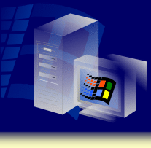
Features of a Modern OS:
Multitasking
Memory Support
SMP Scalability
Remote Installation Services
Operating System
Plug and Play
Terminal Services
Microsoft®
®
Clustering
Windows
QoS
File Systems
NTFS

